Slide 1
Cryptography in Ancient Civilizations
Katie Grossman
Tracie Lo
Lauren Schmetterling

Slide 2

Arab Contributions to Cryptology
Wide contributions were not recognized until recent discoveries of books written by 3 scholars
David Kahn – “Cryptology was born among the Arabs”
Some discoveries are still used in modern cryptography

Slide 3
Factors Behind The Arab Advancement In Cryptology
Translation
Linguistic Studies
Administrative Studies
Public Literacy
Advanced Mathematics
  Concept of zero and Arabic numerals allowed analytical methods such as frequency analysis and computation of letter combinations possible

Slide 4
Al-Kindi (718-786)
Born around 718 in al-Kufa Iraq
Received an education in various sciences
First to recognize the idea of a comprehensive dictionary
Wrote the first known book on cryptology

Slide 5
Al-Kindi’s Contributions
Cryptanalysis techniques
  One for normal text
  One for poetry
Four methods for normal text
  Quantitative techniques
  Qualitative techniques
  Probable words
  Vowel consonant combinations

Slide 6
Al-Kindi Contributions (2)
Tree diagram classification of major types of cipher
PICTURE HERE

Slide 7
Al Khalil’s Contributions (3)
Most important – statistical techniques
  Determined letter frequencies
Set conditions on length of text required for this statistical analysis

Slide 8
Ibn Adlan
Born in Mosul, Iraq in 1187
Received an education in Baghdad and later taught in Cairo
Only wrote 4 books, 2 on cryptology

Slide 9
Ibn Adlan’s Contributions
Concept of Variable key for simple substitution
Detailed study of word spaces
  Used different symbols for spacing
Length should be at least 90 letters long for frequency analysis.
Categorized letters into 3 groups
  Common, Medium, Rare
Most remarkable- step by step method of breaking a cipher

Slide 10
Ibn ad-Durayhim
Born in Mosul in 1312
Most important – in depth description of 8 cipher systems
  Transposition
  Substitution
    Introduced the idea of what is now known as a Vigenere table
  letter addition and omission
  Simple cipher mechanisms
  Arithmetic cipher
  Letter-word substitutions
  Substitution for plaintext letters
  Use of invented symbols for letters

Slide 11
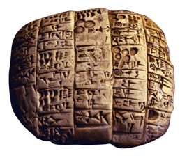
Mesopotamia
Cuneiform Tablet
http://www.asor.org/IMAGES/tablet.jpg
The oldest known example of Mesopotamian cryptography is a small encrypted cuneiform tablet dating about 1500 B.C.E. found on the banks of the Tigris River.
It used cuneiform sign in their least common syllabic values, left out the first consonant of several signs, and used multiple spellings for the same word.

Slide 12
Mesopotamia Cont.
Colophons, stereotyped ending formulas, are used by Babylonian and Assyrian scribes to sign and date their clay tablets.
They substituted the standard signs with rare and unusual ones.
Colophons were later encrypted with numbers substituting the signs.
Tablet fragments have been found that may be part of a colophon codebook, the oldest in the world.

Slide 13
India
Artha-sastra by Kautilya discusses the use of cryptology in political circles.
Officers in institutes of espionage used secret writing to communicate with their spies while they were in the field.
It also contain the first reference in history to the use of cryptanalysis for political gain.

Slide 14
India Cont.
The famous Kama-sutra by Vatsyayana lists secret writing as one of the 64 arts, or yogas, that should be known and practiced.
It is called malachite-vikalpa and two types are described known as kautiliyam and muladeviya.
Kautiliyam is a simple substitution cipher; muladeviya exists in both written and spoken form.

Slide 15
India Cont.
Ancient Indians also made use of verbal and visual codes.
Sabhasa is a form of oral code that uses allusive language.
Nirbhasa is a kind of finger communication or sign language.
These simple codes are still in use today by Indian traders and moneylenders.

Slide 16

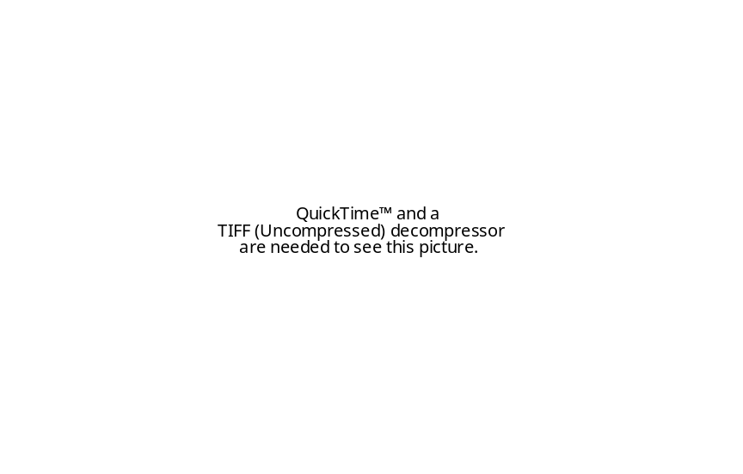
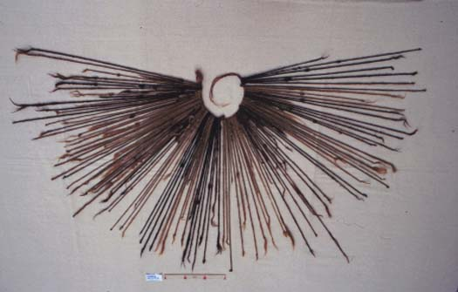
Incan Cryptography
Series of strands made from llama or alpaca hair
Knots on the strings would symbolize numbers, letters, and algebraic functions
Initially for record keeping, but turned into a way to exchange information secretly
About 700 currently known
http://www.anthropology.wisc.edu/chaysimire/titulo2/khipus/quipus.htm
Notes:
600-1000 AD
Initially recorded stories, history, taxes, accounting, labor, and economic activity
Khipu vary in length from a few strands to a few thousand strands

Slide 17
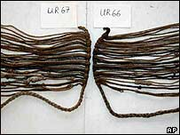
Numerical Usage
About 2/3 of known khipu document numerical data such as accounts and financial transactions
The number zero is represented by the absence of a knot
Number one is represented by a figure eight knot
Digits two through nine are represented by a knot enclosing the proportionate amount of turns
Larger numbers are denoted by combining the smaller digits
http://news.bbc.co.uk/2/hi/americas/4143968.stm
Notes:
Number 2 is represented by two turns and a knot, 3 is represented by three turns and a knot etc
Number 671 would be represented by combining the knots of 6, 7, and 1 and placing them in a row
Confirmed when algebraic equations, such as a summation are preformed- highly unlikely to get the summation of numbers if the knot patterns were incorrectly interpreted

Slide 18
Word Representation
Remaining 1/3 of known khipu represent history, stories, and messages
Letters cannot be easily deciphered
Context determines meaning
Relative position to other strands and strand color are vital
Puruchuco palace was an indicator that khipu were narratives
Not all khipu have been fully deciphered yet
Notes:
Incas had no written language
Letters are represented in numerical form
Deduced that some khipu were narratives after fining a pattern or knots (three figure eights) on almost every khipu at the palace- inferred this arrangement meant Puruchuo

Slide 19
Khipu as Encryption
Estimated that there were many more khipu
When the Spanish invaded the Incas, they banned the code
Especially threatening for a dictator government
Incas could communicate secretly with each other
Notes:
Spanish felt threatened by the code they could not read
Tried to squash its use

Slide 20
Codes of Ancient Greece
All hand written codes
Vary in security
Phiastos Disk- cannot be broken
Scytale- code as simple as they come
Polybius square- one of earliest substitution
Notes:
Drastically different from the Incas who had no written language
Phiastos Disk- 1600 BC- cannot be broken even with modern technology
Only 242 text characters and only known instance of these symbols being used for encryption- lack of text- cannot break

Slide 21
Cryptography in Greek Life
Huge part of life
The Iliad
Aeneas Tacticus- On the Defense of Fortifications
First civilization to make use of cryptology in war- scytale, transposition hilltop distribution
Notes:
Cryptology in literature- Homer writes about Bellerophon brings the king a secret message on tablets that no one can read
Aeneas Tacticus- On The Defense of Fortifications- one of the very first writings on cryptology- discusses stenography too
Scytale in battle- no errors in decryption
Transposition (permutation) ciphers
Also hilltop distribution of the Polybius sqaure- messengers stand on hilltops and hold a torch in each hand- number of times they help left hand up would represent the column of the square and right hand would symbolize row

Slide 22
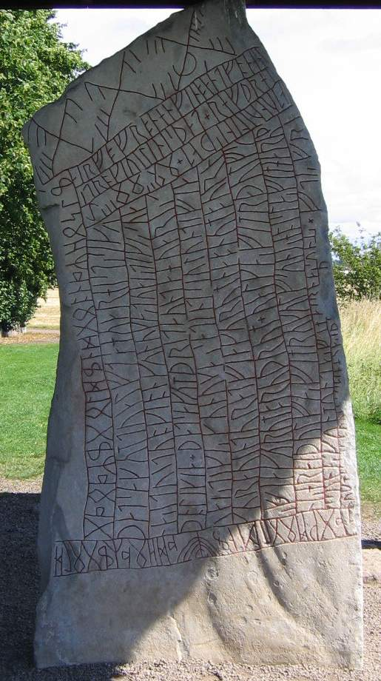

Ancient Europe
The Rok Stone
Germanic people of today’s Britain, N. Europe, Iceland, and Scandinavia used codes in runic
Kylver Stone- oldest runic writing from 400 AD
Rok Stone- written in another variation of runic; dates from 800 AD
http://en.wikipedia.org/wiki/Image:Rökstenen.jpg
Notes:
3rd- 17th century AD
Kylver stone contains enscritopns of stories, fables, poetry, thoguh some writing was purely asthetic
Found in Sweden, inscribed with the older version of runic, Futhark- not yet been deciphered- sealed a grave
Rok stone written in Ogham that contains 725 readable texts and stands at over 13 ft tall- crackable because of so much text
Beginning of Swedish literature

